Slide 1
Emotion Detection From Tweets And Emoticons
Made by-
Jain Rajat Ashok(22)
Dubey Arun Kumar Vyas (14)
Kshatriya Sawan Ranjan(32)
Shukla Pratyush Suresh(58)

Slide 2
Abstract
  Micro blogging sites have millions of people sharing their thoughts daily because of its characteristic short and simple manner of expression. We propose and investigate a paradigm to mine the sentiment from a popular real-time micro blogging service, Twitter, where users post real time reactions to and opinions about “everything”.
  Social networking sites like twitter, Facebook, etc. are the great source of communication for internet users. So these become an important source for understanding the opinions, views or emotions of people.
  We extract data, i.e. tweets from Twitter in real time and apply machine learning techniques to convert them into a useful form and then use it for building sentiment classifier. Given a piece of written text, the problem is to categorize the text into one specific sentiment polarity i.e. positive, negative or neutral.

Slide 3
Problem Statement
• Sentence Level Sentiment Analysis in Twitter:
Given a message, we decide whether the message is of positive negative or neutral sentiment.
For messages conveying both a positive, negative or neutral sentiment, whichever is the stronger sentiment should be chosen.
•Emoticons Level Sentiment Analysis in Twitter:
Given a emoticon whether that instance is positive, negative in that context.

Slide 4
OBJECTIVE
To implement an algorithm for automatic classification of text and emoticons into positive, negative or neutral.
Emotion detection or analysis is to determine the attitude of the mass is positive, negative or neutral towards the subject of interest.
Sentiment classification is a way to analyze the subjective information in the text and then determine the opinion. Sentiment analysis is the procedure by which information is extracted from the opinions, appraisals and emotions of people in regards to entities, events and their attributes.

Slide 5
Objective
The objective of this project is to show how sentimental analysis can be used to recognize user’s mood or emotion using tweets which has been extracted in real time.
The learning algorithm will then learn what our emotions are from statistical data then determine the emotion

Slide 6
Scope and Motivation
We have chosen to work with twitter since we feel it is a better approximation of public
sentiment as opposed to conventional internet articles and web blogs. The reason is that the amount of relevant data is much larger for twitter, as compared to traditional blogging sites.
Moreover, the response on twitter is more prompt and also more general (since the number of users who tweet is substantially more than those who write web blogs on a daily basis).
This could be done by analyzing overall public sentiment towards that firm with respect to time and using economics tools for finding the public sentiment.
Firms can also estimate how well their product is responding in the market, which areas of the market is it having a favorable response and in which a negative response.

Slide 7
LITRETURE REVIEW
Author : Sameesksha Shrivastava, Dr. Pramod S. Nair
Topic :Mood Prediction on Tweets Using Classification Algorithm
Abstract :In this the authors uses identified twitter data set which is used to perform text analysis. Therefore, the entire input data samples are required to classify in two classes namely positive and negative. Therefore, in this paper a binary classifier namely ID3 decision tree and their improved variant is utilized for analysis and performing the classification task

Slide 8
LITRETURE REVIEW
Year : 2015
Author : Brett Duncan and Yanqing Zhang
Topic : Neural Networks for Sentiment Analysis on Twitter
Abstract: Sentiment analysis can be used to find out the polarity of an opinion, such as positive, negative, or neutral. Sentiment analysis has applications such as companies getting their customer's opinions on their products, political sentiment analysis, or opinions on movie reviews. In this paper, a feedforward Neural Network is used to classify the text as being positive, negative, or neutral.

Slide 9
LITRETURE REVIEW
Year : 2015
Author : Akshi Kumar, Prakhar Dogra and Vikrant Dabas
Topic : Emotion Analysis of Twitter using Opinion Mining
Abstract : In this author intend to categorize the opinion on the basis of five emotions, namely Happiness, Anger, Fear, Sadness & Disgust, which have been globally accepted & defined in human psychology. A two-step approach is proposed, to identify the sentiment; extract the opinion words (a combination of the adjectives along with the verbs and adverbs) in the tweets and subsequently use a novel algorithm to find the emotion values of opinion words.

Slide 10
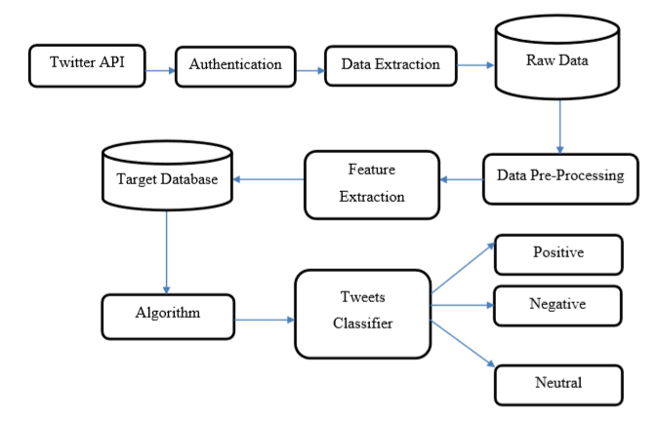
PROPOSED SYSTEM

Slide 11
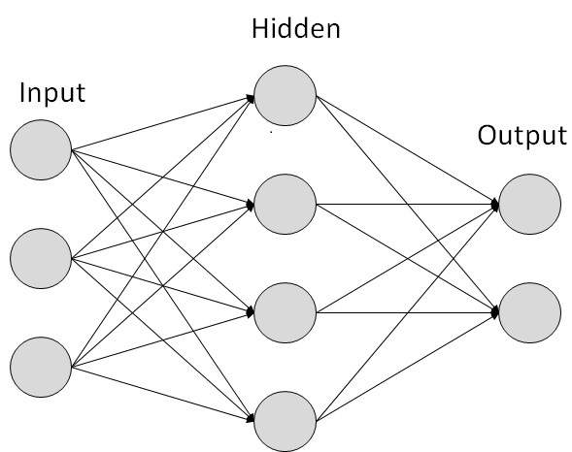
METHODS AND ALGORITHM
An Artificial Neural Network (ANN) is a computational model. It is based on the structure and functions of biological neural networks. It works like the way human brain processes information. It includes a large number of connected processing units that work together to process information
And Machine Learning Algorithms like Naïve Bayes.

Slide 12
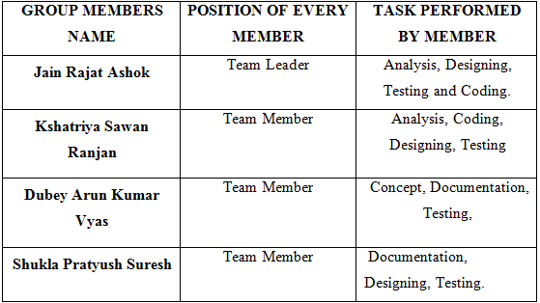
Implementation Details

Slide 13
import twitter4j.*;
import twitter4j.auth.OAuth2Token;
import twitter4j.conf.ConfigurationBuilder;
import java.io.BufferedWriter;
import java.io.FileWriter;
import java.io.IOException;
import java.util.List;
import java.util.Map;
public class Buscador {
public static void main(String [] args) throws TwitterException, IOException{
ConfigurationBuilder cb = new ConfigurationBuilder();
cb.setDebugEnabled (true)
.setOAuthConsumerKey ("ExhS1Ua9U8mDgYOR6vFytEWzw")
.setOAuthConsumerSecret ("wfRgBtPLVPcrmuF2I9lk55fkp7hvUr706FdBsi9u1NWnuROy3q")
.setOAuthAccessToken ("1047828476626124800-E6Z7c4elvTLVHsSrYdgOYUasSY18d3")
.setOAuthAccessTokenSecret ("j8fGHB2E71YvQj3nK8JAI2ZZ4NM3JoXEVg95JHcokjllX");
TwitterFactory tf = new TwitterFactory (cb.build ());
Twitter twitter = tf.getInstance ();
Query query = new Query(“navrathri");
QueryResult result = twitter.search(query);
do{

Slide 14
List<Status> tweets = result.getTweets();
StringBuilder sb = new StringBuilder(); for(Status tweet: tweets){
System.out.println("User: "+tweet.getUser().getScreenName() + " Tweet: "+tweet.getText()); try(BufferedWriter bw = new BufferedWriter(new FileWriter("C:\\Users\\User\\Desktop\\results4.csv")))
{
String tweetText = tweet.getText();
String username = tweet.getUser().getScreenName(); long tweetId = tweet.getId(); sb.append("\n\nID= \n ").append(tweetId).append("\nUser= \n ").append(username).append("\nTEXT= \n ").append(tweetText);
String csvText = sb.toString(); bw.write(csvText); bw.newLine();
}
} query = result.nextQuery(); if(query!=null) result = twitter.search(query);
}while(query!=null);
}
}

Slide 15
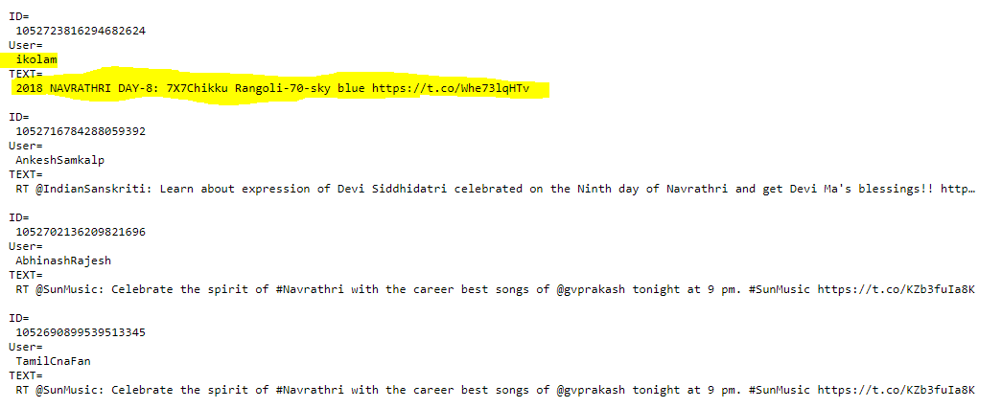

Slide 16
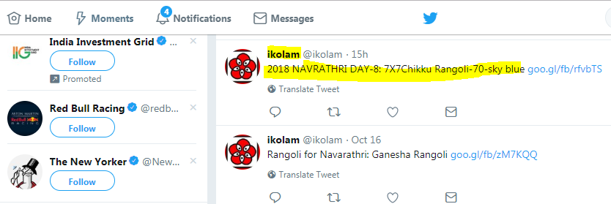

Slide 17
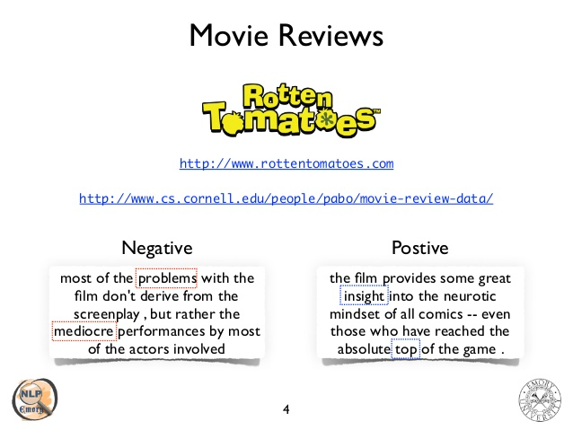
Applications
Used in Movie reviews

Slide 18
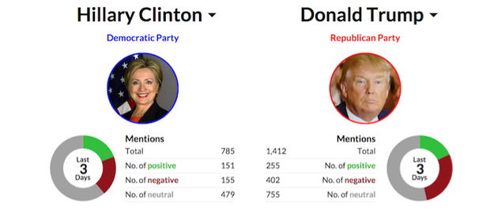
Knowing public opinion for political leader or their notions about rules and regulations

Slide 19
Future Work
Using different other models and algorithms.
Temporal analysis can be added as a future work in the project.
Consideration of Retweets as a factor.

Slide 20


